Slide 1
Best neighborhood in Tokyo for ballet school
Prepared by Eriko McDermott for Capstone Project

Slide 2
Introduction
The ABC schools of ballet in US is planning to open a new school in Tokyo, Japan
We will find the best neighborhood in Tokyo for a location of the new school.

Slide 3
Data
Geographic data of the neighborhoods in Tokyo downloaded from https://www.aggdata.com/free/japan-postal-codes
Ballet school and other venue data obtained from Foursquare

Slide 4
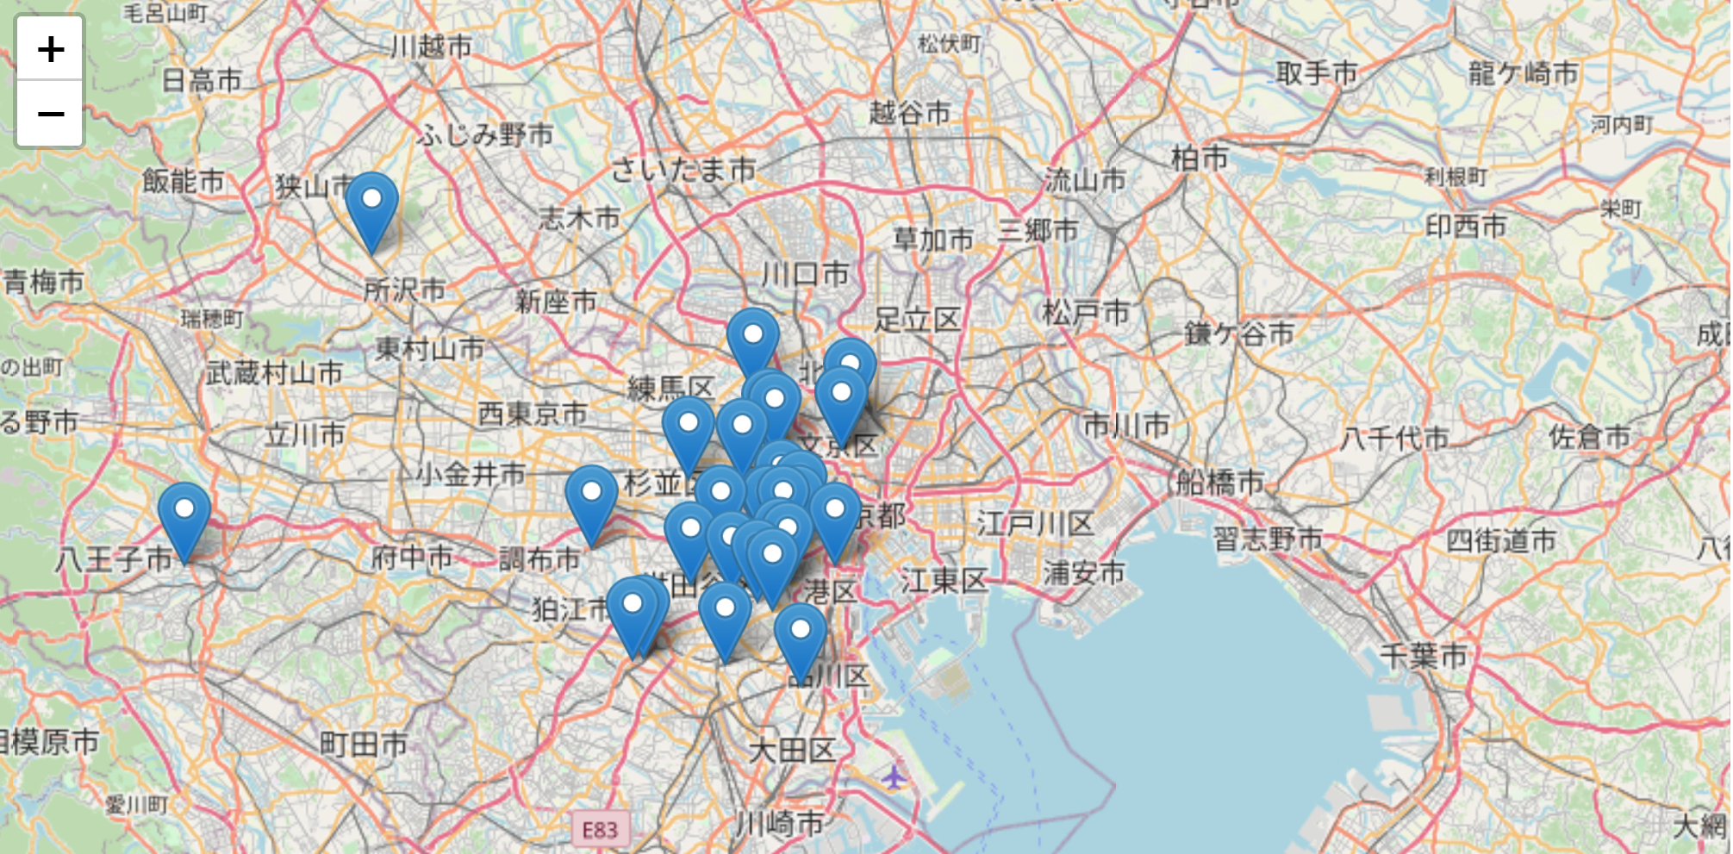
Ballet schools in Tokyo

Slide 5
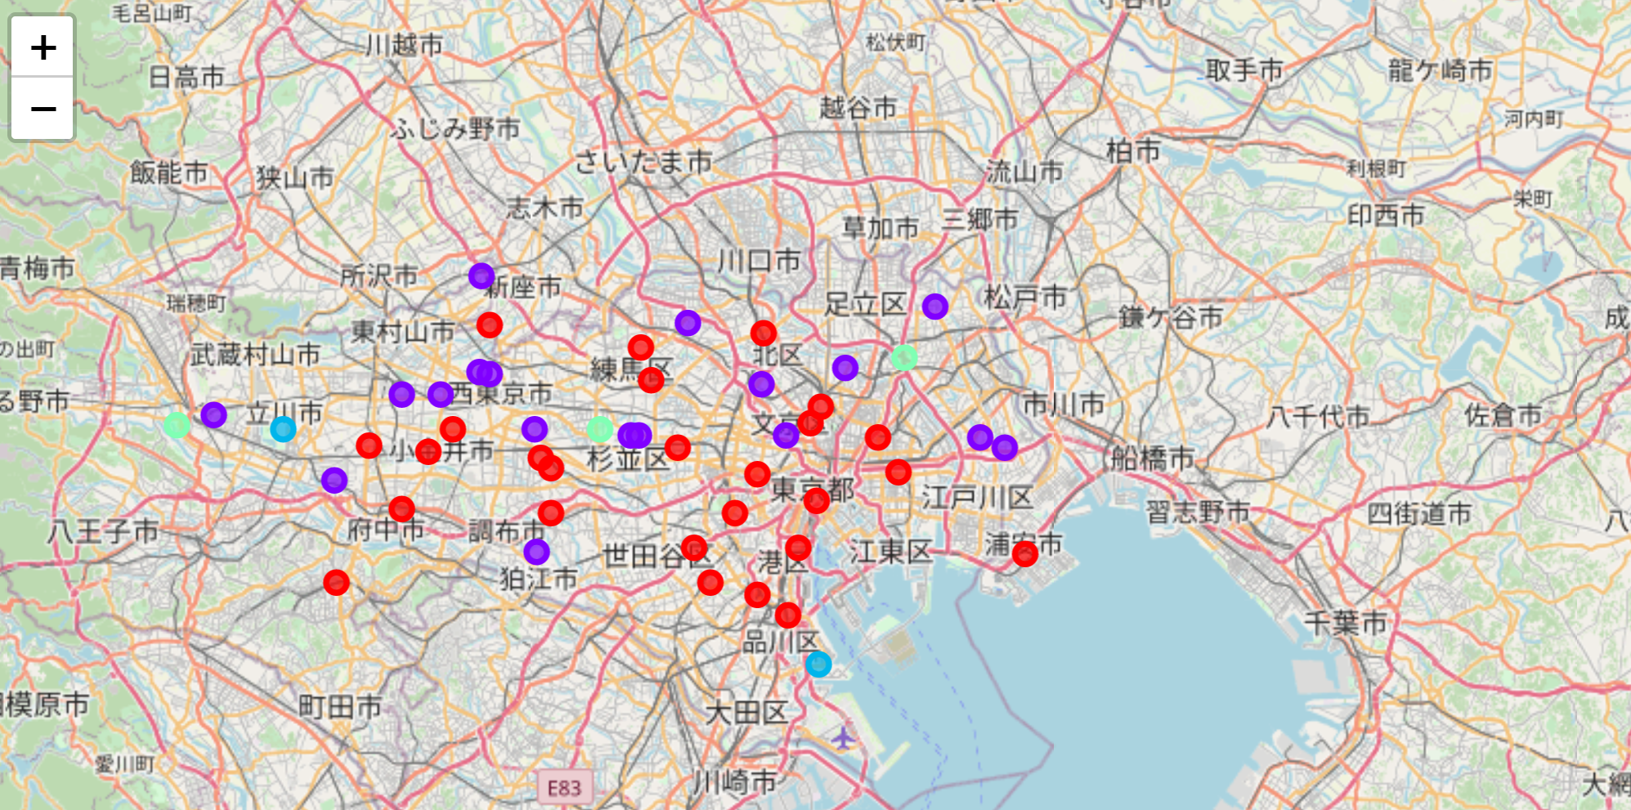
Clustered neighborhoods

Slide 6
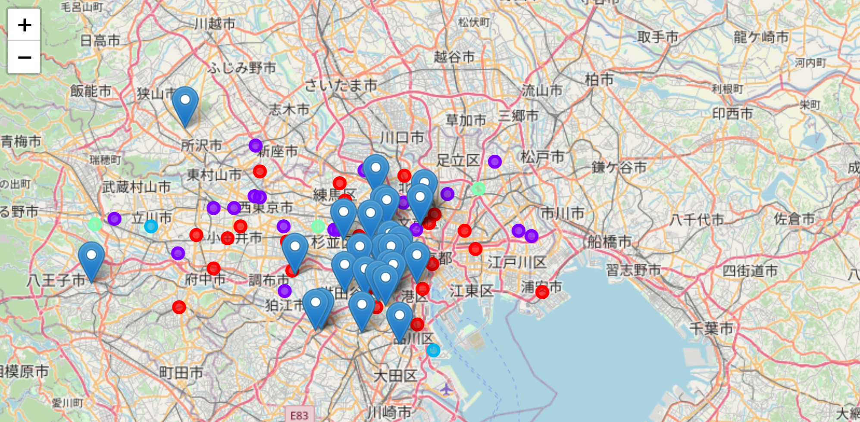
Ballet schools and Neighborhoods

Slide 7
Conclusion / Discussion
The recommended locations of a new ballet school will be the red neighborhoods in the outskirt of the metropolitan area.
The recommended locations can be narrowed by considering other factors such as real estate and accessibility.

